Slide 2
1000, 100, 10, 1 ppb
BTEX in Air
with
Calidus GS-T
“Limit of quantification”

Slide 3
Objectives
Separate and identify ppb-level BTEX components in air
benzene
toluene
ethylbenzene
meta- & para-xylene (not separated)
ortho-xylene
Establish repeatability at varying concentrations with an RSD of <5% per component
Concentration levels : 1000ppb, 100ppb, 10ppb, 1ppb
Establish linearity for each component across the four orders of magnitude
Explore possibility of parts per trillion level measurements

Slide 4
Calidus GS-T Configuration

Slide 5
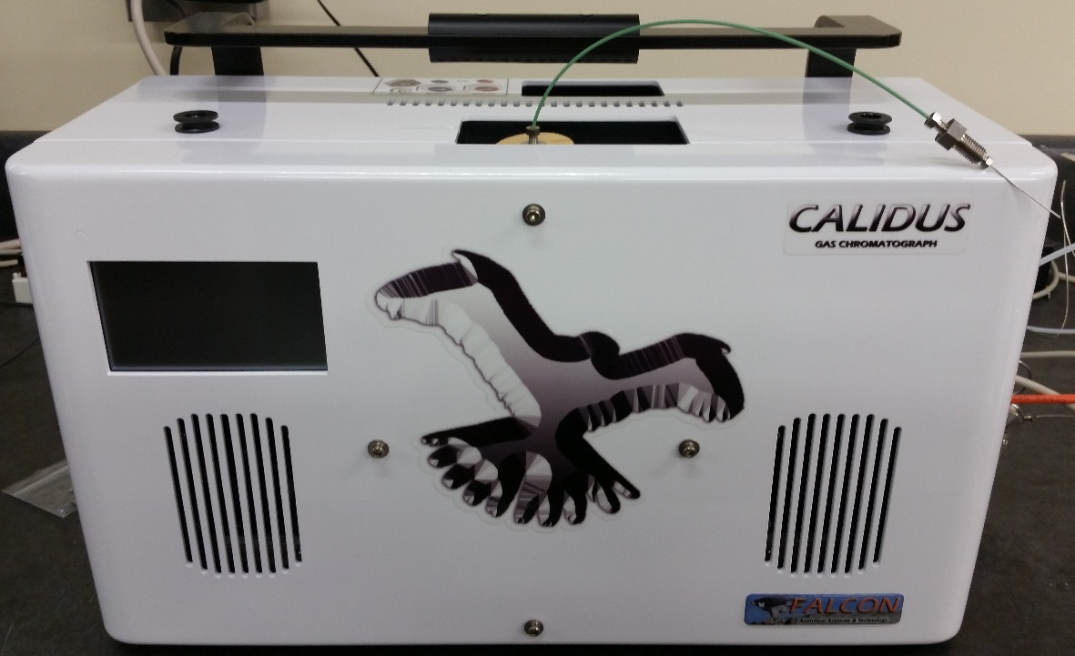
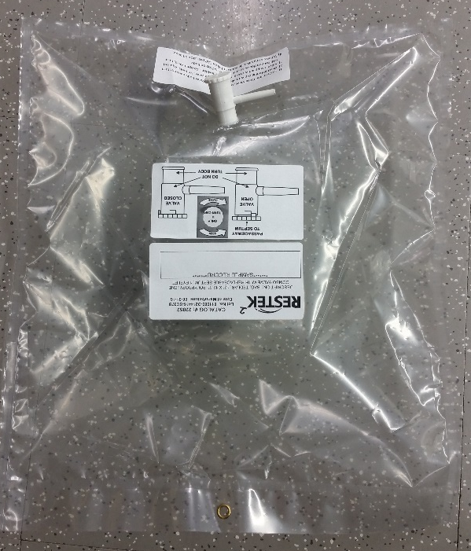
Calidus GS-T Configuration
The GS-T sample pump consistently loads the trap module for an adjustable length of time
Sample is drawn from the top of the instrument for ambient air measurements
To meet the objectives of this test, sample was drawn from Tedlar® bags via a needle at the end of a length of PEEKTM tubing

Slide 6
Calidus Method
The vacuum pump was set to concentrate sample in the trap module for 100 seconds
Approximately 50 mL of air is drawn with a sample pump time of 100 seconds
The injection was splitless
Sample was concentrated and held isothermally on the trap at 35°C during the 100s sample collection
After this time, the trap module was quickly ramped at 20°C/s to 250°C
The concentrated contents of the 250°C trap module were “injected” onto the Q-Bond column module where the BTEX components were separated and measured

Slide 7
BTEX Sample Preparation
BTEX was injected into several zero air-filled Tedlar bags in order to achieve the desired concentrations of 1ppb, 10ppb, 100ppb, and 1000ppb
All concentrations refer to benzene in BTEX
All other compounds are present at about 25% lower concentrations
For example, at the 100ppb level, individual component concentrations were:
benzene: 100ppb
toluene: 85ppb
ethylbenzene: 74ppb
o,p,m-xylene: 74ppb each

Slide 8
OBJECTIVES 1 and 2 – Identification and Repeatability

Slide 9
BTEX – 1000ppb
Unknown hydrocarbons suspected to be inherent in the Tedlar bags at concentrated levels is noticeable in three large non-interfering peaks

Slide 10
8 Runs Overlaid - 1000ppb

Slide 11
8 Runs Area Repeatability – 1000ppb
Run Number | benzene | toluene | ethylbenzene | p+m-xylene | o-xylene
1 | 283225 | 273159 | 231392 | 564746 | 282758
2 | 283194 | 275630 | 231541 | 567166 | 281034
3 | 279843 | 272464 | 228479 | 559647 | 277142
4 | 285006 | 277541 | 232522 | 571944 | 285854
5 | 285418 | 278216 | 234280 | 571646 | 286893
6 | 286189 | 279068 | 233980 | 574886 | 287709
7 | 280800 | 271309 | 228156 | 558204 | 276504
8 | 284837 | 278308 | 233433 | 573476 | 286632
Average | 283564 | 275712 | 231723 | 567714 | 283066
Std. Dev. | 2260 | 3026 | 2348 | 6354 | 4457
%RSD | 0.80 | 1.10 | 1.01 | 1.12 | 1.57

Slide 12
BTEX – 100ppb
Only two unknown peaks from this Tedlar bag
Dip in baseline due to large plug of air in the sample hitting the FID

Slide 13
8 Runs Overlaid - 100ppb

Slide 14
8 Runs Area Repeatability – 100ppb
Run Number | benzene | toluene | ethylbenzene | p+m-xylene | o-xylene
1 | 30700 | 27253 | 24660 | 54206 | 29361
2 | 30885 | 27351 | 24760 | 54577 | 29536
3 | 30749 | 27230 | 24674 | 54258 | 29289
4 | 30709 | 27140 | 24626 | 54108 | 29317
5 | 30504 | 27174 | 24399 | 53940 | 29072
6 | 30694 | 27376 | 24562 | 54278 | 29344
7 | 30542 | 27138 | 24528 | 53760 | 29105
8 | 30301 | 26683 | 24189 | 53154 | 28769
Average | 30635 | 27168 | 24550 | 54035 | 29224
Std. Dev. | 180 | 215 | 182 | 431 | 235
%RSD | 0.59 | 0.79 | 0.74 | 0.80 | 0.81

Slide 15
BTEX – 10ppb
Dip in baseline due to end of splitless time at 100s

Slide 16
8 Runs Overlaid - 10ppb

Slide 17
8 Runs Area Repeatability – 10ppb
Run Number | benzene | toluene | ethylbenzene | p+m-xylene | o-xylene
1 | 2796 | 2453 | 2091 | 4413 | 1866
2 | 2687 | 2513 | 2097 | 4501 | 1863
3 | 2644 | 2462 | 2117 | 4444 | 1910
4 | 2629 | 2422 | 2091 | 4432 | 1890
5 | 2713 | 2468 | 2126 | 4482 | 1915
6 | 2707 | 2490 | 2153 | 4480 | 1921
7 | 2667 | 2491 | 2159 | 4528 | 1938
8 | 2618 | 2463 | 2087 | 4416 | 1871
Average | 2683 | 2470 | 2115 | 4462 | 1897
Std. Dev. | 57 | 28 | 29 | 42 | 28
%RSD | 2.14 | 1.13 | 1.36 | 0.94 | 1.49

Slide 18
BTEX – 1ppb

Slide 19
8 Runs Overlaid - 1ppb
Baseline rise and drift due to column bleed as column approaches max temp

Slide 20
8 Runs Area Repeatability – 1ppb
Run Number | benzene | toluene | ethylbenzene | p+m-xylene | o-xylene
1 | 230 | 264 | 143 | 511 | 118
2 | 223 | 267 | 149 | 511 | 117
3 | 210 | 261 | 142 | 510 | 123
4 | 215 | 248 | 150 | 479 | 122
5 | 219 | 253 | 146 | 504 | 112
6 | 218 | 264 | 140 | 507 | 113
7 | 227 | 266 | 157 | 527 | 118
8 | 219 | 266 | 139 | 500 | 114
Average | 220 | 261 | 146 | 506 | 117
Std. Dev. | 6 | 7 | 6 | 13 | 4
%RSD | 2.87 | 2.64 | 4.13 | 2.67 | 3.34

Slide 21
OBJECTIVE 3 – Linearity

Slide 22
Linearity (1, 10, 100, 1000ppb)

Slide 23
OBJECTIVE 4 – Parts Per Trillion Measurements

Slide 24
BTEX – 500ppt

Slide 25
BTEX – 250ppt

Slide 26
Overlay - 1ppb, 500ppt, 250ppt (zoomed to see benzene and toluene)
1ppb
500ppt
250ppt

Slide 27
Objectives Met
All components exhibited an RSD of 5% or better (much better in most cases) at all four concentration levels of 1, 10, 100, and 1000ppb
All components exhibited linear responses through four orders of magnitude with R squared values of 0.9999 or better (1.0 in most cases)
Parts per trillion levels of BTEX components were still detectable and integrateable by the Chromperfect software

Slide 28
Further Studies
Some of the later eluting peaks would likely benefit from a lower final temperature hold on the Q-Bond
The method in this study brought the column to its maximum temperature limit of 300°C in order to increase speed of analysis
This high temperature hold caused the baseline to rise towards the end of the run which made the integration of some peaks (especially at the lower ppb and ppt levels) very difficult
Seeing even lower ppt levels than this experiment showed would be possible by pulling air through the sample pump for longer than 100s

